Slide 1
Welcome to MS PowerPoint
Name: Hamza Shahid
Roll# 24K-0869
Task: ICT Manual 2 Lab Task 1

Slide 2
Introduction
Easy to present anything
Made by a reliable company (Microsoft)
It is widely used everywhere around the world

Slide 3
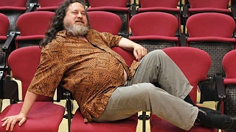
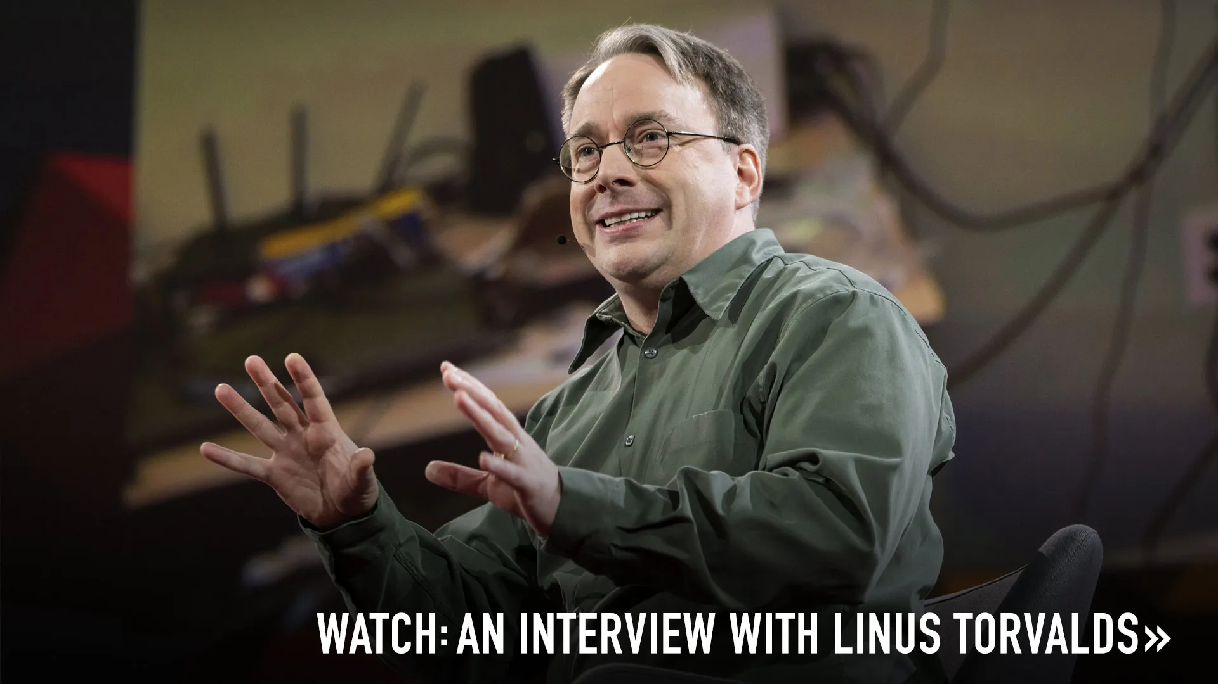
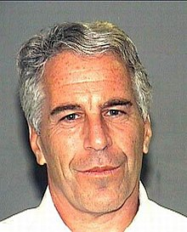
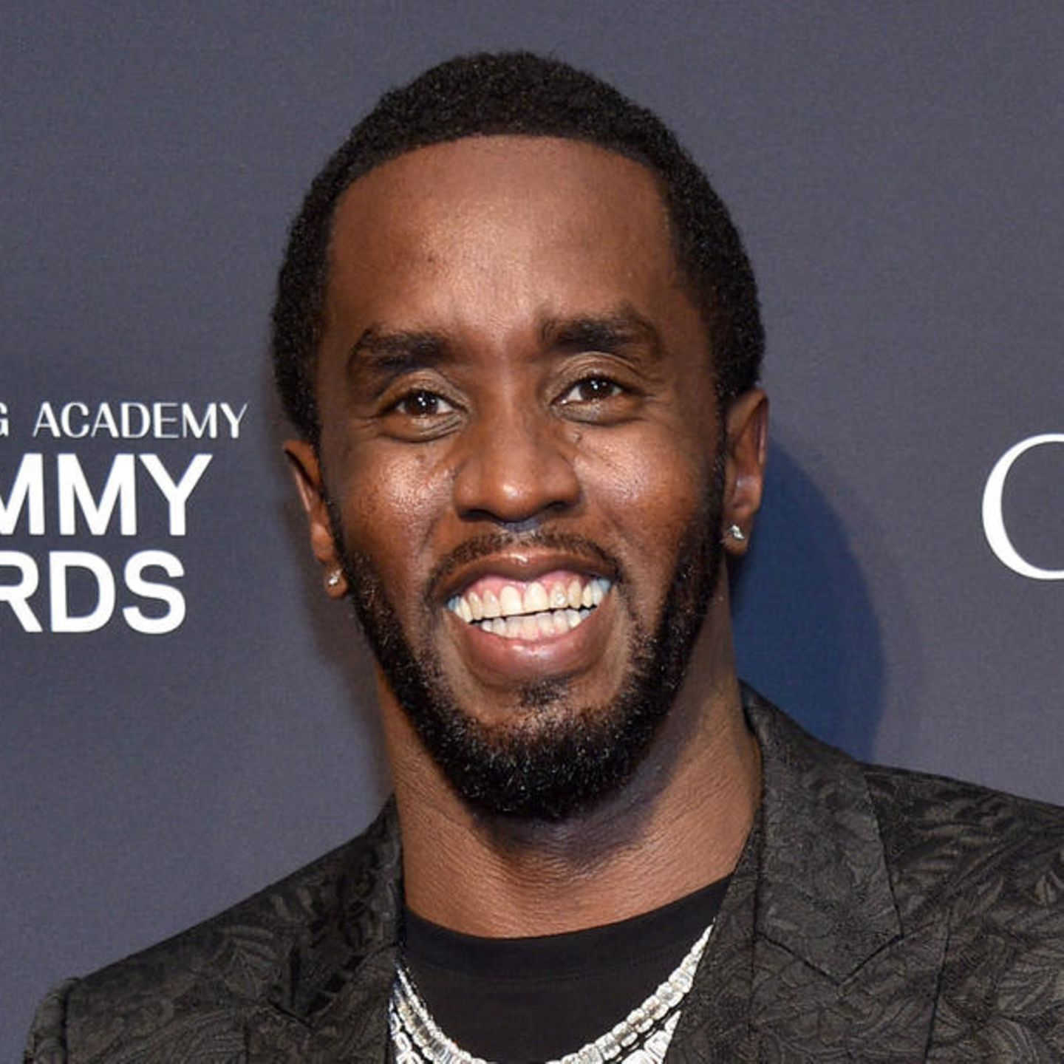
Our Team

Slide 4
REPL (Read-Eval-Print-Loop)
Read
Read an expression from user
Eval
Evaluate the expression
Print
Output onto screen
Loop
Start all over again

Slide 5
Resources
Visit Microsoft

Slide 6
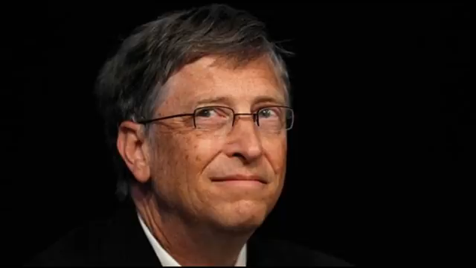
5 Ways Windows is Better Than Linux (April Fools)

